Slide 1
Psychomotor Skill Management
Parut Singhapun 5710503496
3 September 2017

Slide 2
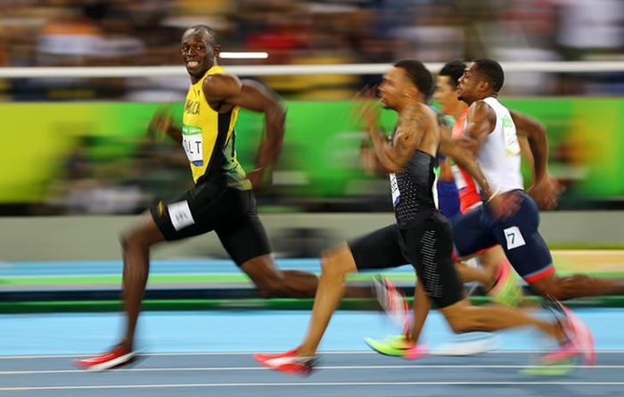
MotiVation
To improve the athlete’s performance
To improve the reaction skill of the testers

Slide 3
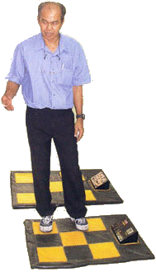
9-Square-table
Inventor : Assoc. Prof. Charoen Krabuanrat
Goal : Practice brain and body skills

Slide 4
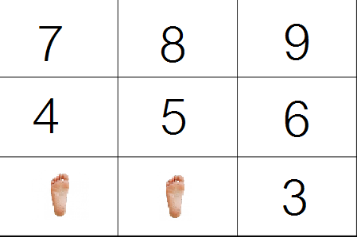
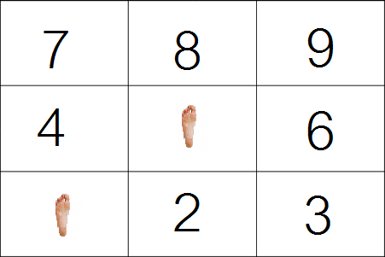
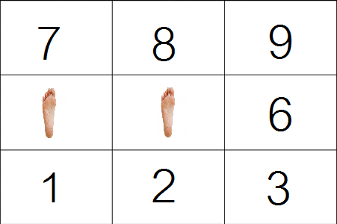
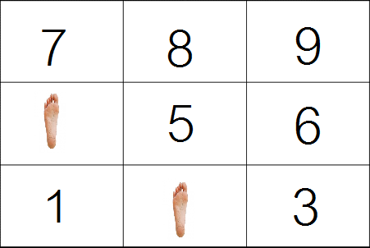
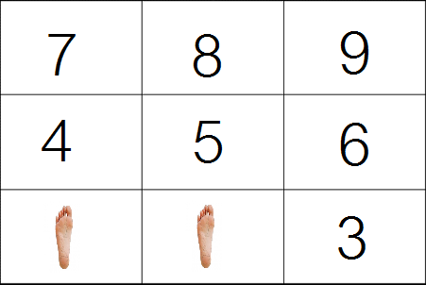
How to play
AS FAST AS YOU CAN!

Slide 5
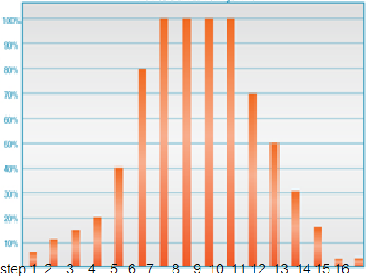
Psychomotor Skill Management
Get data from tester and analysis the results
Examiner can change form of input to his/her own idea or create his/her new form
Monitoring the output in form of graph and statistic detail

Slide 6
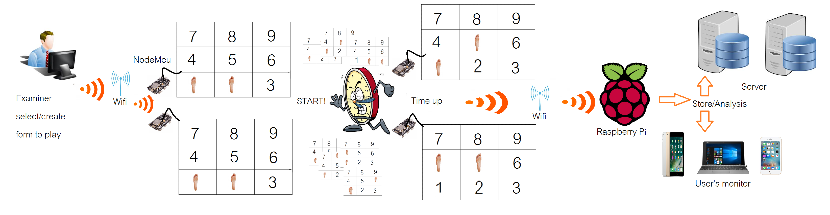
System overview

Slide 7
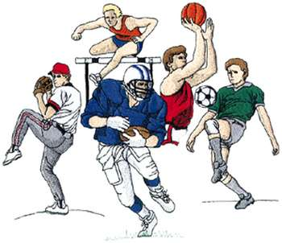

Target
Athlete of Kasetsart University
Faculty of Education, Kasetsart University

Slide 8
Requirement
The format pattern MUST be accurate.
Can show output in form of (Step, Set)
Examiner can select form to play and can create the format pattern themselves
(Optional) Double Table

Slide 9
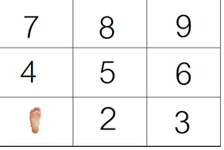
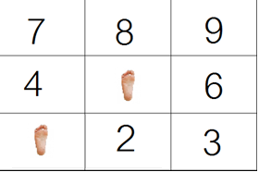
Double Table
Two player alternate play by the first player add his/her first step
The second player must repeat it and add his/her own step

Slide 10
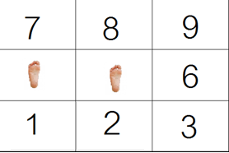
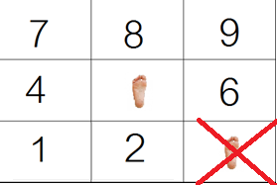
3. First player must repeat it and add his/hers.
4.Repeat until someone fail

Slide 11
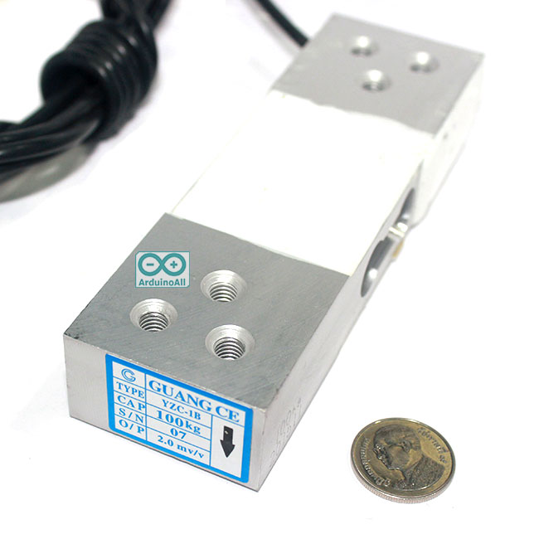
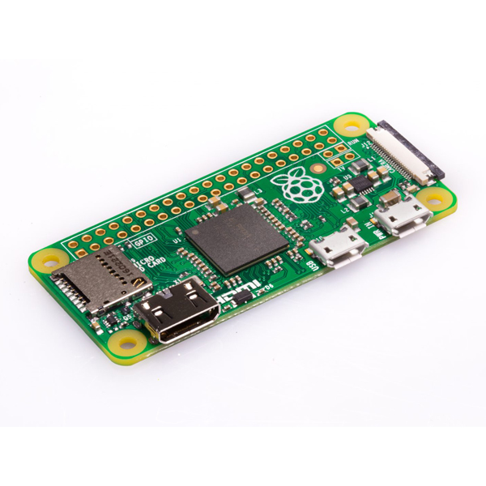
Equipment
Weight Sensor (Load Cell) 0-100 kg
Raspberry Pi, Arduino

Slide 12
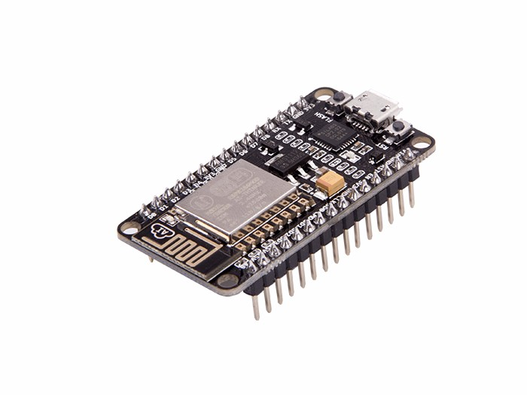
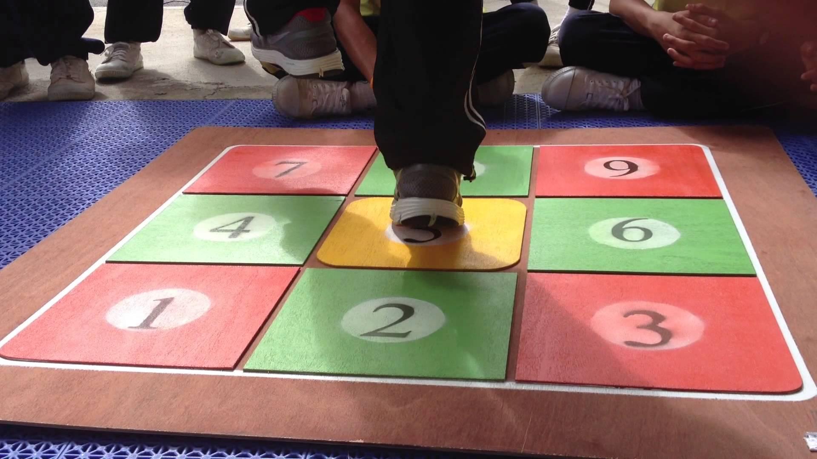
NodeMcu
9 Square board

Slide 13
References
https://i.ytimg.com/vi/NaKMg1bQ-TI/maxresdefault.jpg
http://www.pngall.com/wp-content/uploads/2016/04/Server-PNG-Image.png
http://www.ku.ac.th/english/images/webnew/logo.jpg
https://img2.annthegran.com/StockDesign/XLarge/Dakota_Collectibles/sp0607.jpg

Slide 14
ANY QUESTION?

